Slide 1
Professor
Jorge Alfonso Meléndez Acuña

Slide 2
Welcome

Slide 3
Schedule
Network Science for Data Analytics
Unit 1
Introduction to Network Analysis
Unit 2
Centrality
Measures
Unit 3
Introduction to Network Models
Unit 4
Community Detection
Unit 5
Error and Attack Tolerance
Unit 6
Graph Machine Learning
Introduction to
Data Science
Basic Concepts of Graph Theory
Hubs
Communities
Vulnerability in networks
Machine Learning with Graphs
Introduction to Network Science
Small Worlds
Network Models
Deep Learning with Graphs

Slide 4
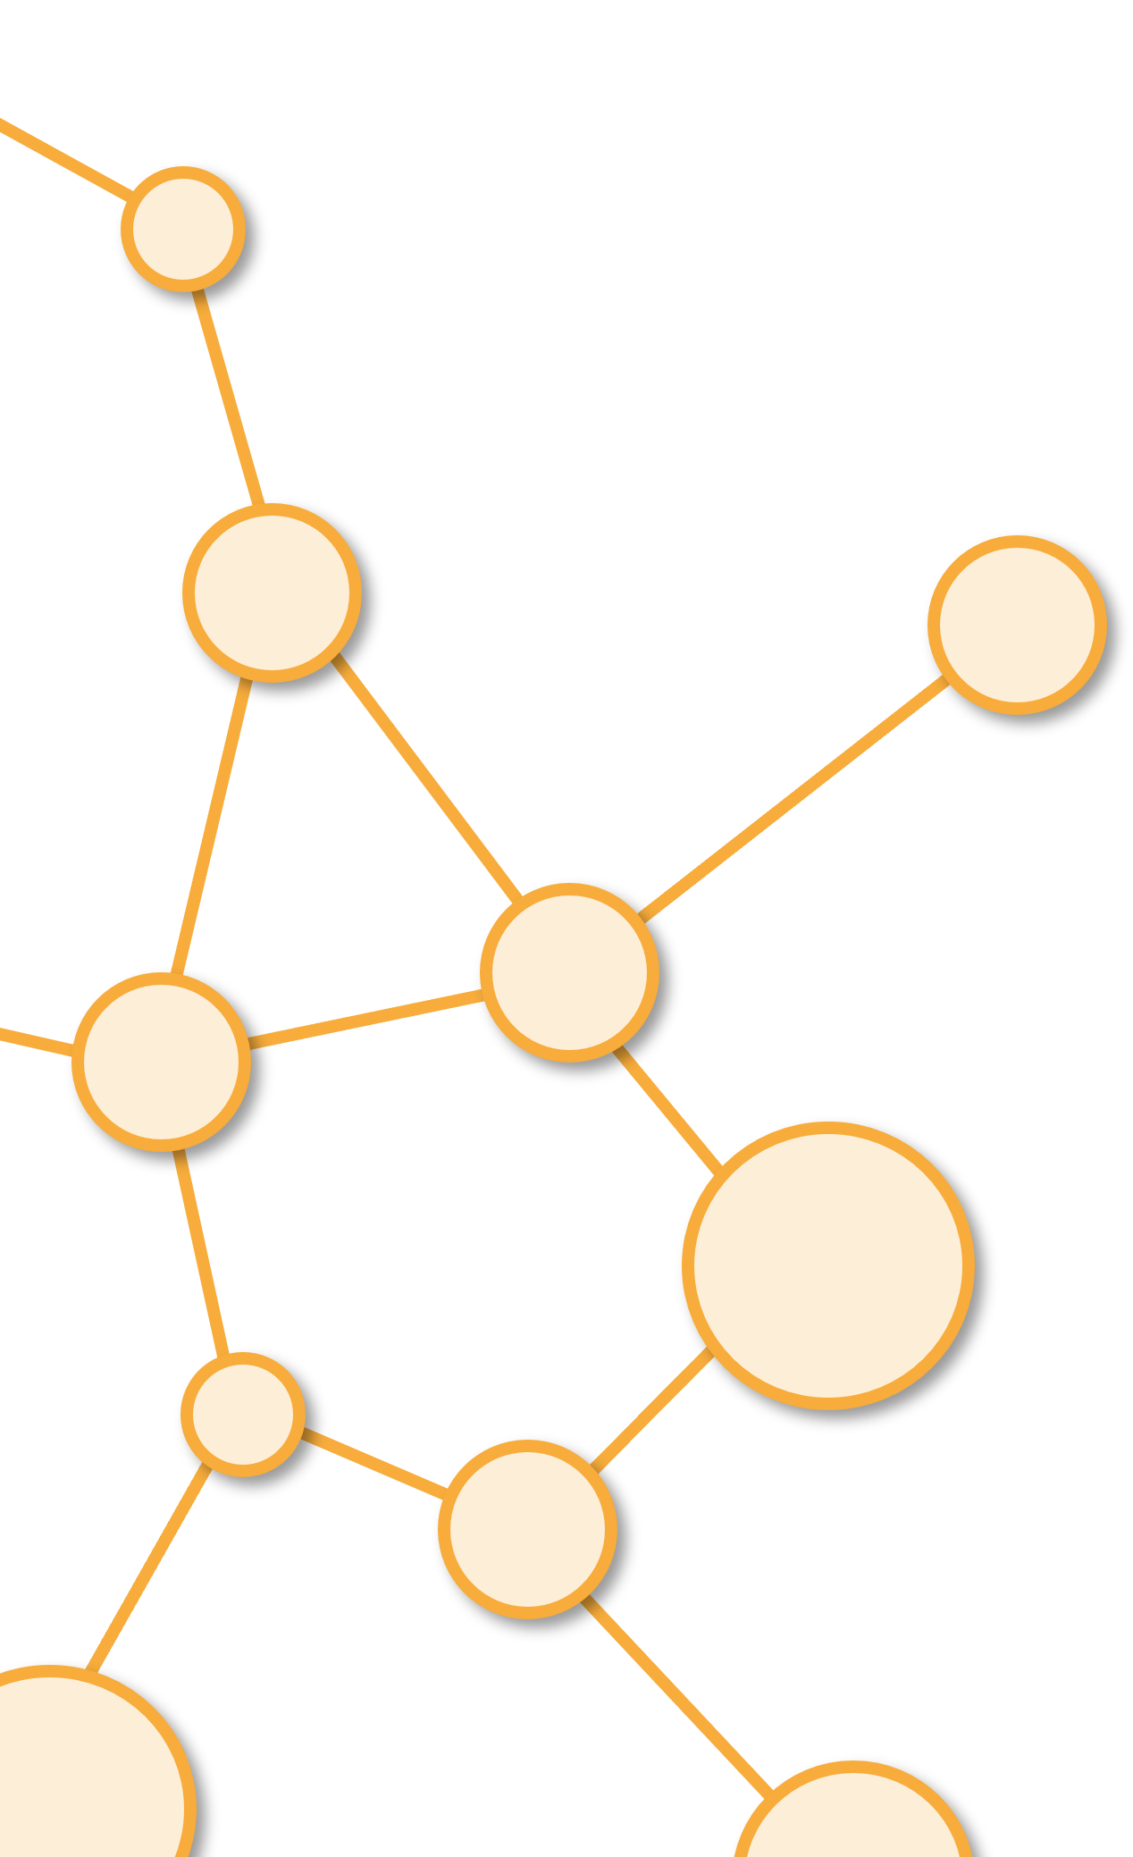
Introduction to Network Models
Unit 3

Slide 5
Outline
2. Network Models

Slide 6
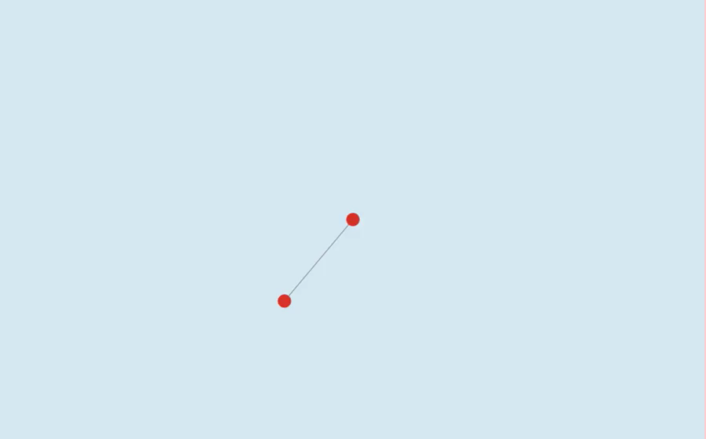
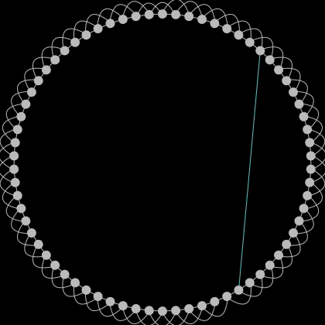
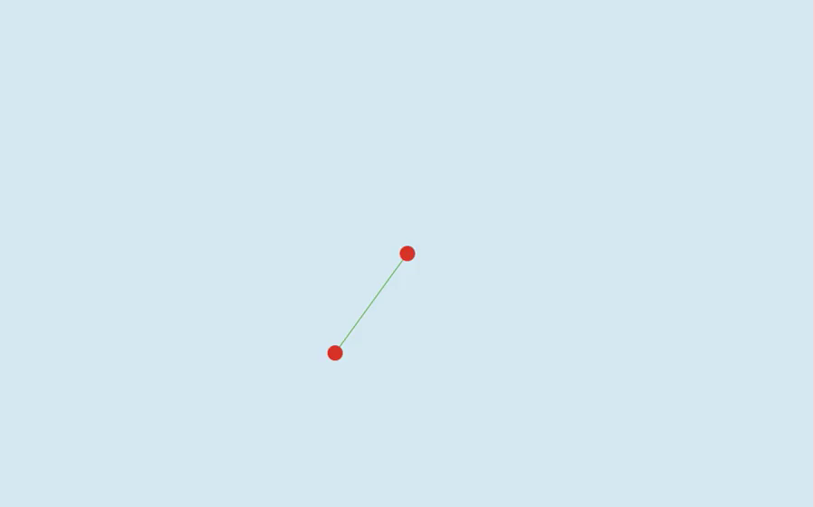

Slide 7
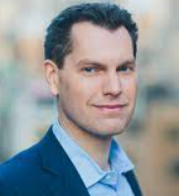
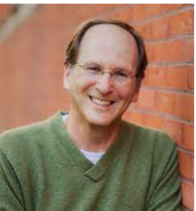
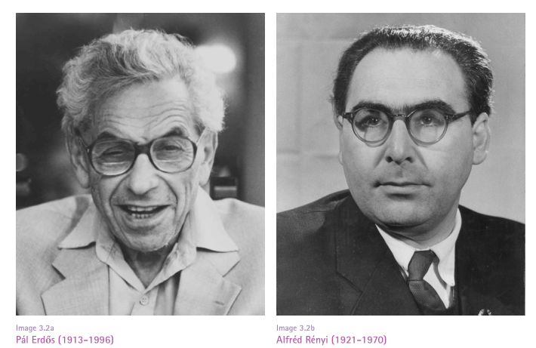
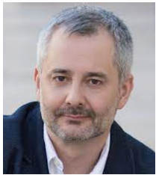
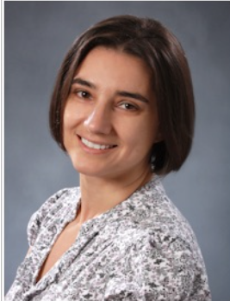
Synthetic (Artificial) Networks
At the very beginning of network analysis, there was a widespread lack of data.
Some of the most brilliant mathematical minds in the field determined different ways to create synthetic network data by defining network models.
These models are the subject of this part of the course.

Slide 8
Three Reasons (1)
Explanatory
After you analyze a bunch of real world networks, you may realize they all seem to have a common property:
Broad degree distribution.
Incredibly high clustering
Communities
And you ask yourself: how did these properties arise?
You might want to apply very simple rules, to see if they can repro-
duce the property of interest. If you succeed, you might be closer to
explain their origins.

Slide 9
Three Reasons (2)
Analysis and testing
You want to generate fake networks that are as similar as possible to real world networks.
They must have the same properties, especially the ones that are important for your research.

Slide 10
Three Reasons (3)
Description
you might find a network with a peculiar property. You might ask yourself not how this property arose, but if it is something you would expect any network to have.
You want to estimate the statistical significance of that observation.
It is pretty hard to talk about statistical significance when you have a single observation – a single network.
So you might want to generate random networks with the same properties of your observed one and see if they all have that characteristic of interest.

Slide 11
Random Networks
Erdos-Renyi

Slide 12
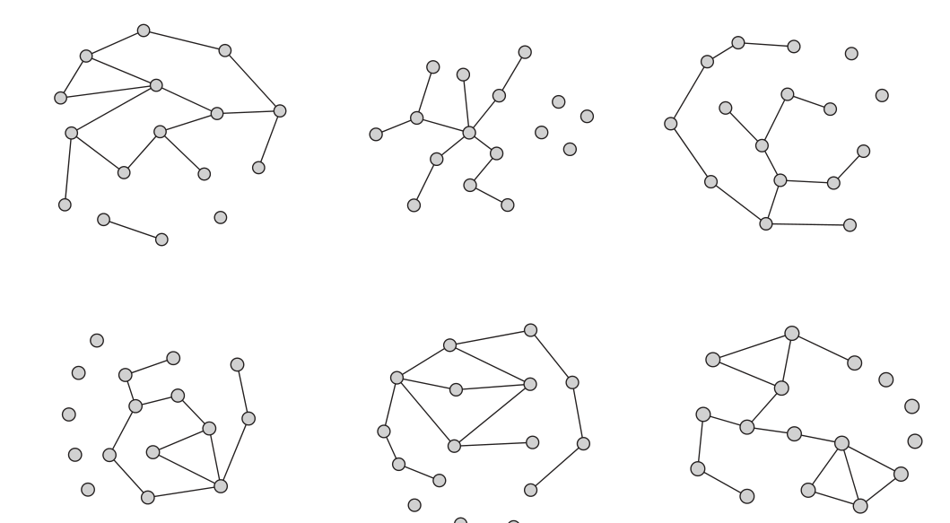
G(n,p): n=16 , p=0.125

Slide 13
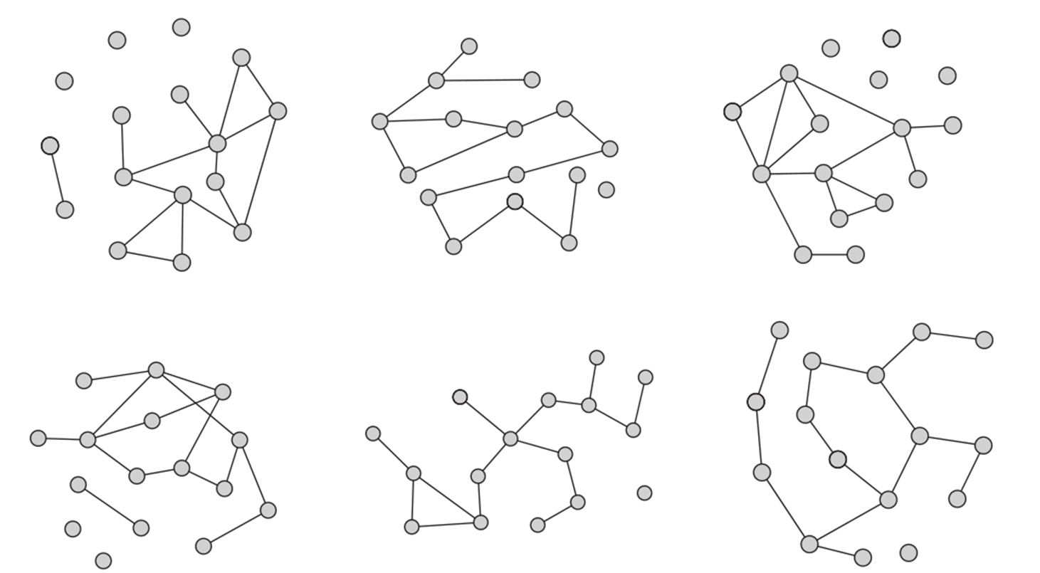
G(n,m): n=16,m=15

Slide 14
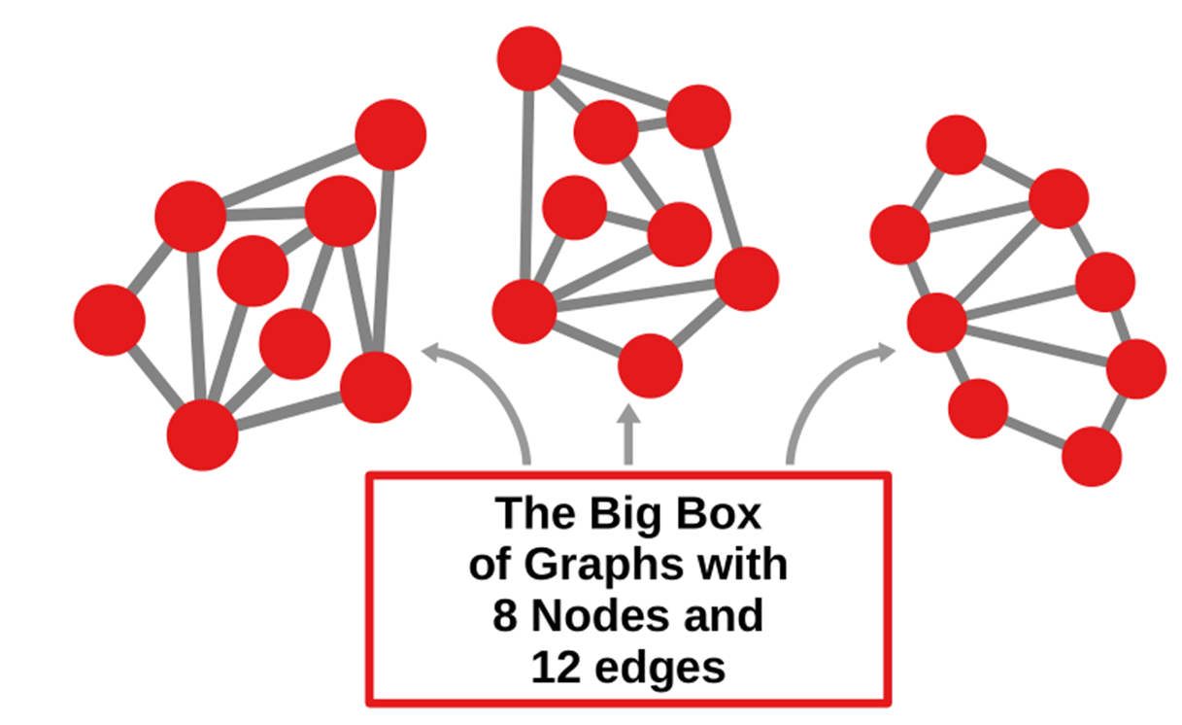

G(n,m) n=8 , m=12
Link to Random Model

Slide 15
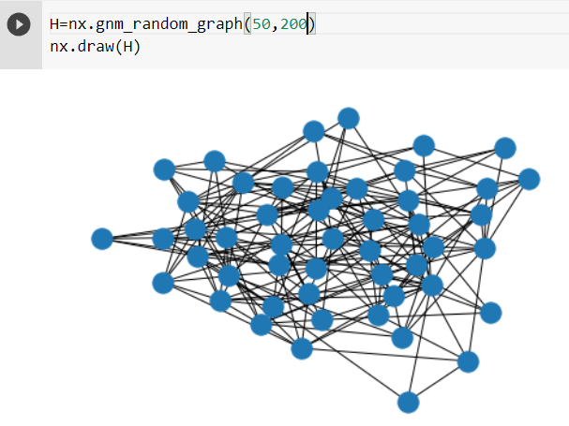
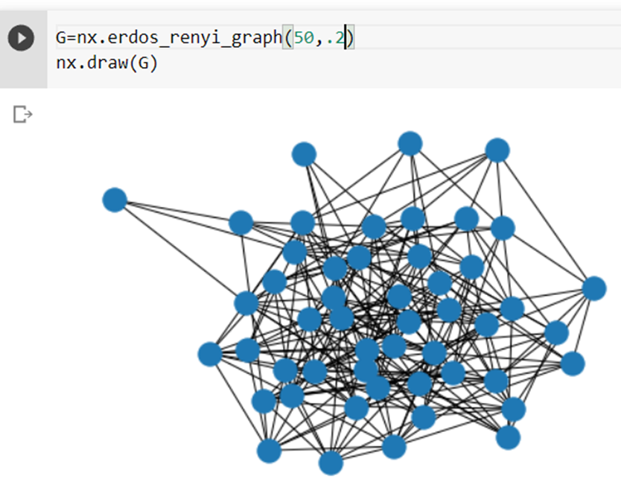
1. Random Networks Networkx
N=5,M=200
(Erdos-Renyi)
N=50,p=.2
(Gilbert)

Slide 16
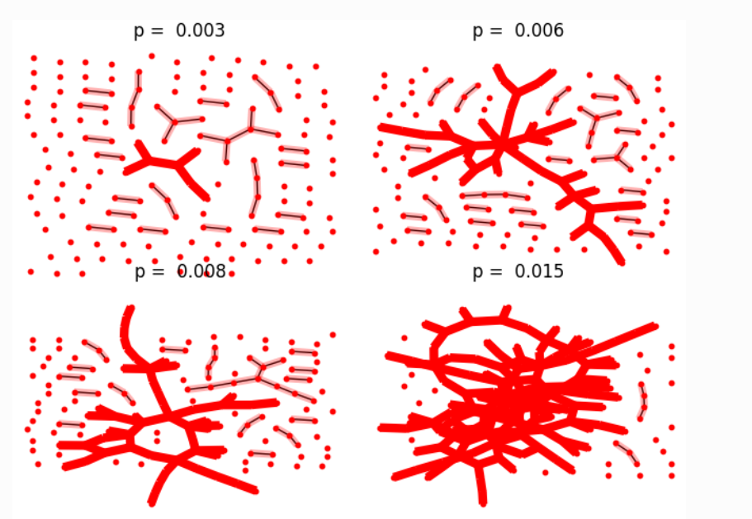
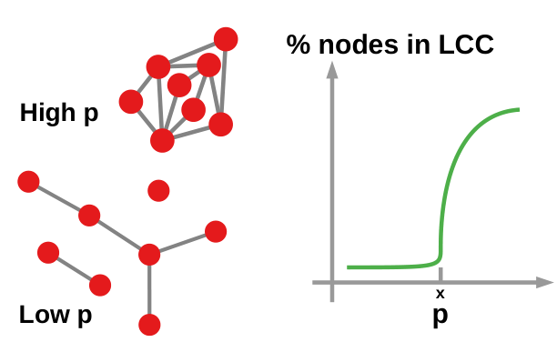
Evolution of a G(n,p) Network
Link to Threshold Model
Link to Giant Component

Slide 17


Random Graphs
Low Clustering (Few Triangles)
Short Paths.
No Hubs ( homogeneity of node degrees, Poisson).
Giant Component
Link to Properties Model

Slide 18

Small World Networks
Watts-Strogatz
Why high level of clustering and small path length of real world networks?
Small World Networks Andrew Beveridge
Video Melanie Mitchell

Slide 19
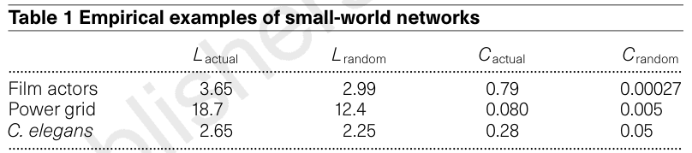
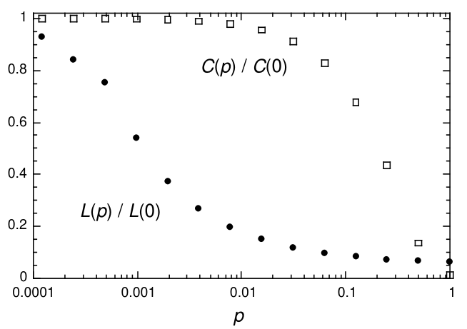
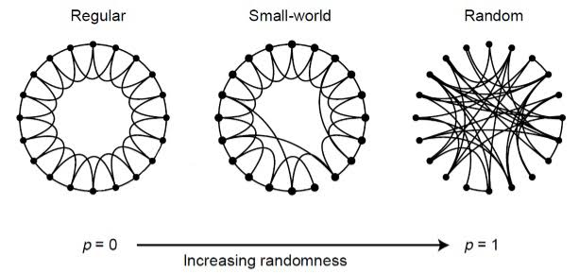
Important Result

Slide 20
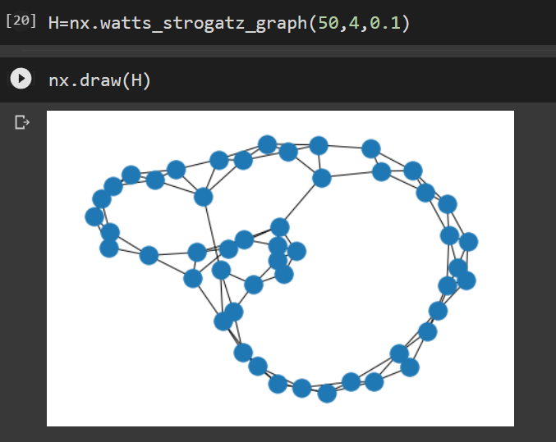
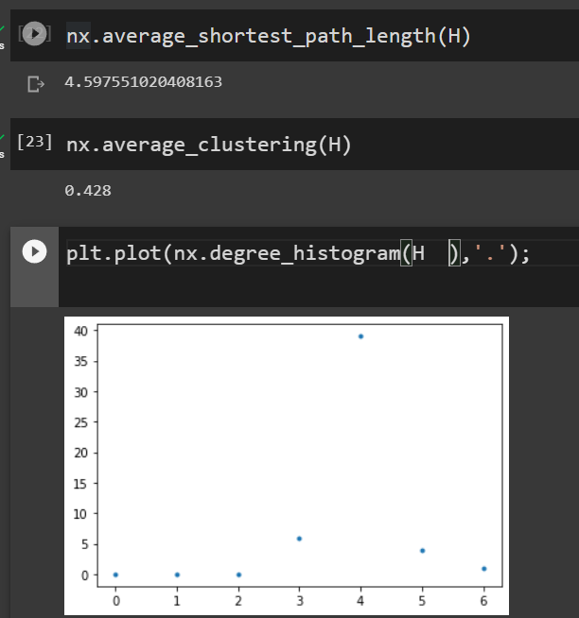
Small World
High Clustering (Triangles).
Short Paths.
No Hubs ( homogeneity of node degrees).
Link to Properties Model

Slide 21
Scale Free Networks
Barabasi-Albert
Scale Free Part 1
Why power law degree distributions?
Scale Free Part 2

Slide 22
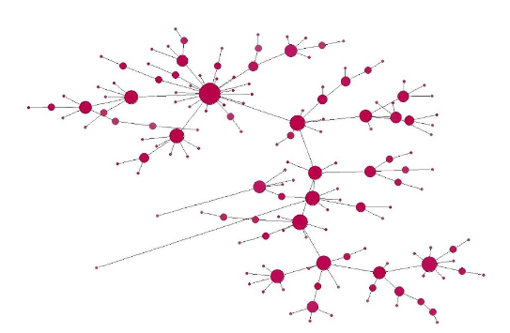
Preferential attachment
Link to Netlogo Model
Link to Complete Model

Slide 23
Basic Properties of the three models (1)
Random:
Low Clustering (Few Triangles).
Short Paths.
No Hubs ( homogeneity of node degrees).

Slide 24
Basic Properties of the three models (2)
Small World:
High Clustering (Triangles).
Short Paths.
No Hubs ( homogeneity of node degrees).

Slide 25
Basic Properties of the three models (3)
Preferential:
High Clustering (Triangles).
Short Paths.
Hubs ( hetereogenity of node degrees).

Slide 26
The Three Models
Link to Three-Model
Si hay Tiempo….
Link to Diffussion-Attack

Slide 27
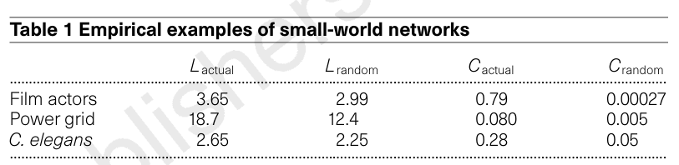
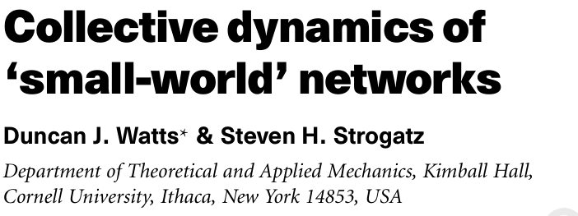
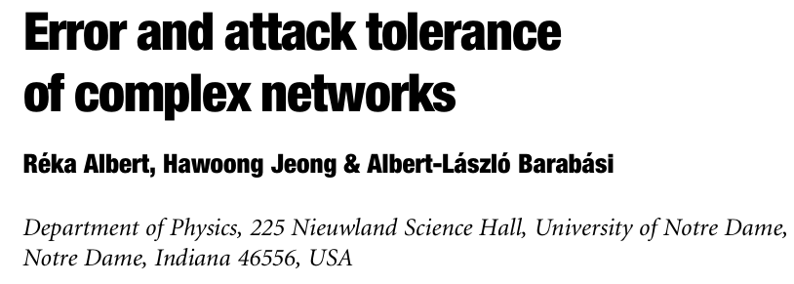
Real World Networks

Slide 28
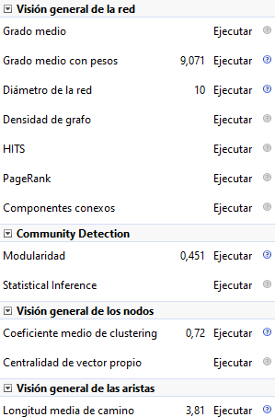
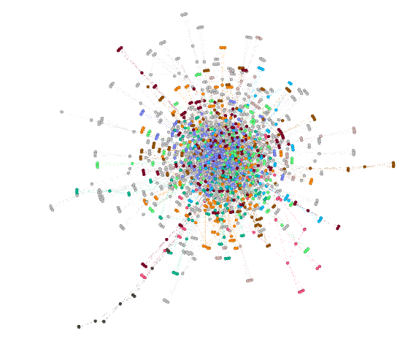
Film Actors
Nodes: 1613
Links: 6691
Link to Model

Slide 29
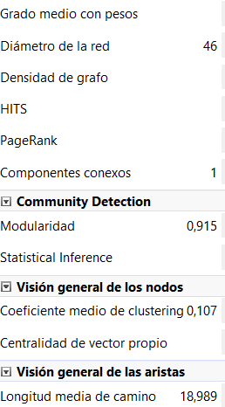
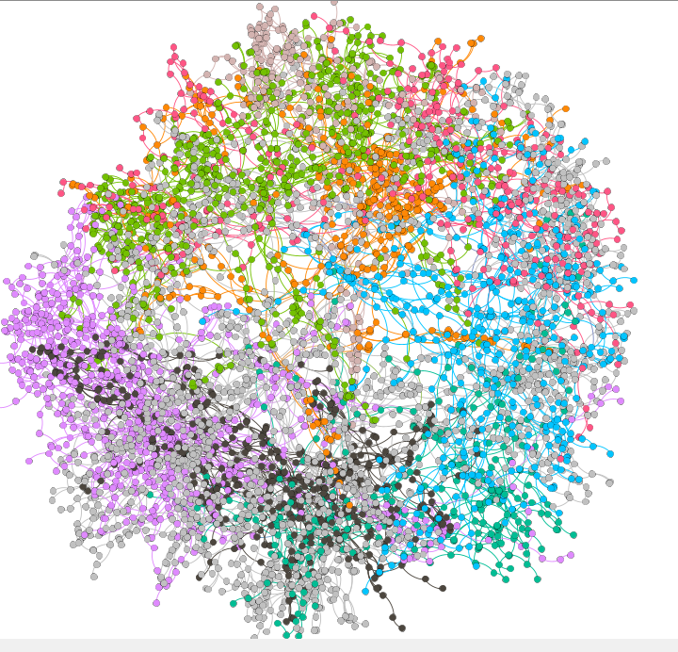
Power Grid
Nodes: 4941
Links: 6594
Link to Model

Slide 30
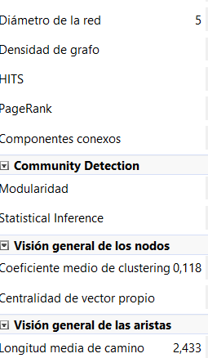
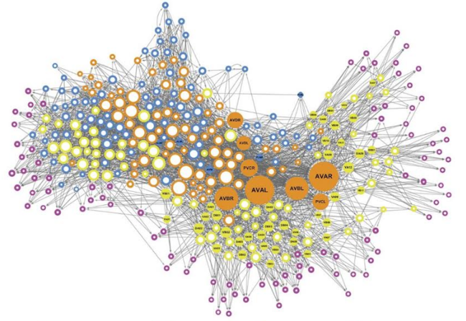
Celegans
Nodes: 297
Links: 2179
Link to Model

Slide 31
The Promise of Network Science
Link to Video (17:26)

Slide 32
!
Activities
Tarea 3 parte 1
Tarea 3 parte 2
Taller Tutoría 3
Con los datos de la red Juego de Tronos, desarrollar los 7 numerales descritos en OpenEdX
Comentar en el Foro ¿A cuál de los modelos de redes vistos en clase, se aproxima más la red de Juego de Tronos y por qué?
Notebook: Modelos de redes

Slide 33
!
Campuswire
Foro - Proyecto
Foro General
Foro General
Preguntas / Comentarios sobre el proyecto
Preguntas sobre aspectos metodológicos
Preguntas sobre los temas del curso
Preguntas sobre el uso de herramientas tecnológicas

Slide 34
Good bye

Slide 36
Credits
Subject Matter Expert
Instructional Designer
Jorge Alfonso Meléndez Acuña
Angela Maria Arboleda Restrepo
Subject Matter Expert
Graphic Designer
Luis Fernando Niño Vásquez
Tania Valentina Flórez Rincón
First version
Date: April 2025

